Slide 1


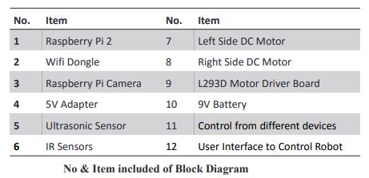
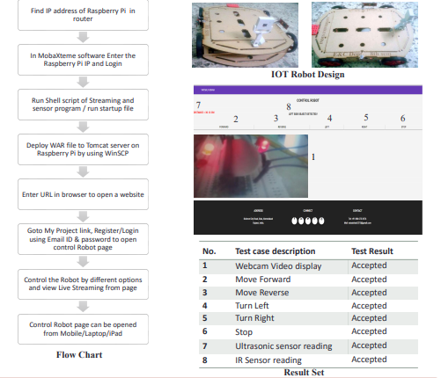

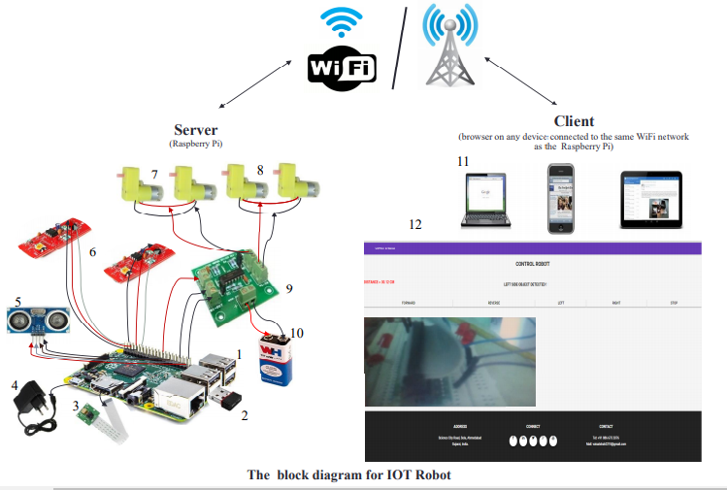
Students Seminar
Organized by
The Robotic Society
JMI Chapter
IOT BASED ROBOT
AUTHORS : Nirmal Gupta 15BME0051 Umair Hussain 15BME0055 Yasir Ashfaque 15BME0056
Abstract
The purpose of this poster is to demonstrate the synergistic combination of the IOT with a robot with an interface board of the Raspberry Pi, sensors and software to full fill real time requirement.
Controlling DC motors, different sensors, camera interfacing with raspberry Pi using GPIO pin.
Live streaming, Command the robot easily, sends data of different sensors which works automatically or control from anywhere at any time
Design of the website and control page of robot is done using Java tools and HTML. This system works on IOT concept.
This will enable Raspberry Pi to be used for more robotic applications and cut down the cost for building an IOT Robot
FLOW CHART AND RESULT
Objectives
To develop an IOT based robot, which can be controlled by a mobile devices/ computer over the Internet / Wi-Fi from anywhere at any time.
  Gather system requirements
  Evaluate and study the platform required for the system
  Evaluate and study suitable development language, technologies and tools
  Evaluate Methods of Interface
  Program Raspberry Pi
  Interface board for dc motors
  Program Website & Control Page
  Evaluate and test the system
  Maintain system
Methodology
Conclusions
  In the future this technology can be used in various different fields of work apart from the usage discussed in this poster.
  The robot can be made autonomous with the help of more sensor, gyroscope, compass and a GPS. So that it can be set to a target or a specific area where in can monitor.
  Adding the Pneumatics design in Mechanical so robot can go up and down, can hold the object.
References
  Research Directions for the Internet of Things, John A. Stankovic, Life Fellow, IEEE
  Design and build a Raspberry Pi robot By Stewart Watkiss, (Penguin Tutor)
  Build and Interface Internet Mobile Robot using Raspberry Pi and Arduino by Prof. Dr. Nabeel Kadim Abid Al-Sahi

